Slide 1

PATH CONTROLLED MOVEMENT OF ROBOTIC ARM
BATCH MEMBERS:
Mr. K.NIRANJAN
Mr. S NISHANTH
Mr. KS NITHISH ABHINAV
GUIDED BY:
Mr. Sathish
Assistant professor

Slide 2
AIM
TO DESIGN AN ALGORITHM TO OBTAIN A PATH CONTROLLED MOVEMENT OF ROBOTIC ARM .

Slide 3
OBJECTIVES
TO ENABLE THE POSSIBLITIES OF OPERATING THE ARM IN LINEAR MOVEMENTS WITH HIGH ACCURACY.
TO ACCESS THE POSSIBLITIES OF AUTOMATION TECHNOLOGIES.

Slide 4
INTRODUCTION
ARM BASED ROBOTS ARE CAPABLE ONLY TO MOVE IN A RADIAL MOVEMENT.
ROBOTIC APPLICATIONS NEED STRAIGHT AXIS MOVEMENTS AND PATH CONTROLLED MOVEMENTS WHICH CANNOT BE ACHIVED MANUALLY
WITH THE COMBINATION OF SENSORS AND MATHEMATICAL CALCULATIONS IT IS ACHIVED.

Slide 5
BLOCK DIAGRAM
INPUT FOR DIRECTION
MATHEMATICAL
FUNCTION
SERVO MOTORS

Slide 6
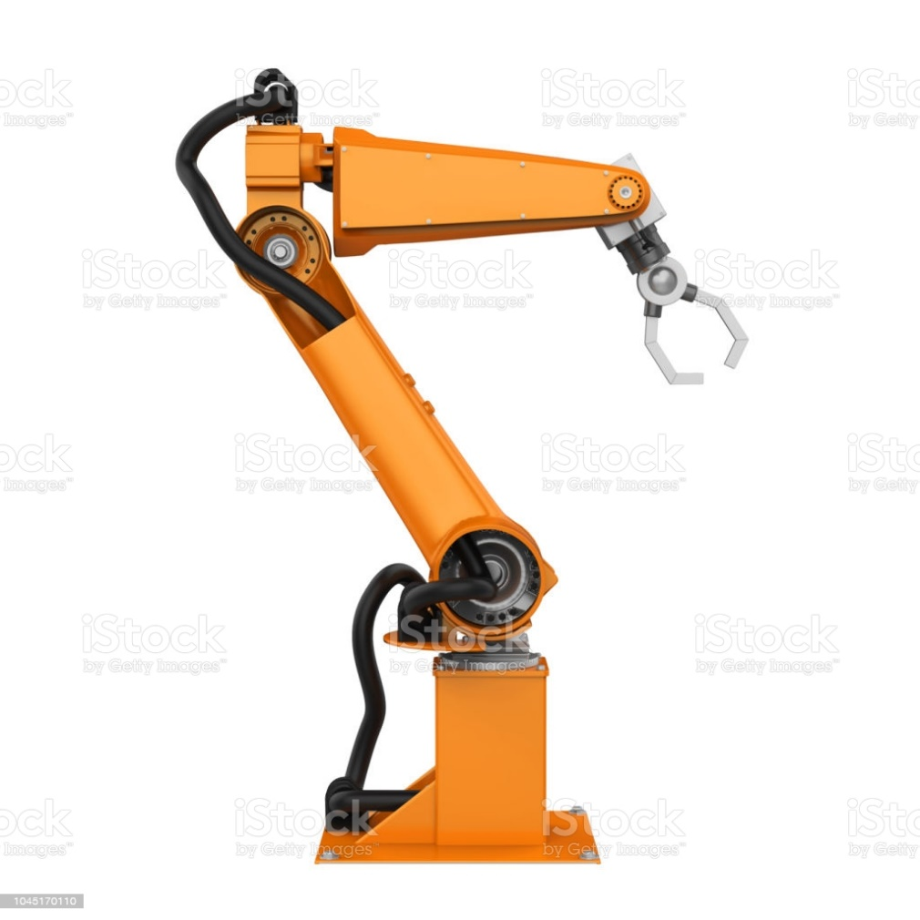
EXISTING GENERAL SYSTEM
Control 1
Control 2
Control 3

Slide 7

Circle 2
r2
(h3,k3)
or
(x2,y2)
Circle 3
r3
(h2,k2)
or
(x1,y1)
(h4,k4)
or
(x3,y3)
(h1,k1)
r1
Circle 1

Slide 8
REFERENCES
1.Joachim Holtz, "State of the art of controlled AC drives without speed sensors", International Journal of Electronics, pp. 249-263, Nov 2010.
2.Hamid A. Toliyat and Steven G. Campbell, "DSP-Based Electromechanical Motion Control (Power Electronics and Applications Series)" in , Publisher: CRC Press, September 2003.

Slide 9
THANK YOU

